Slide 1
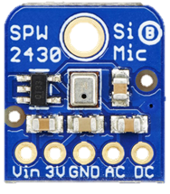
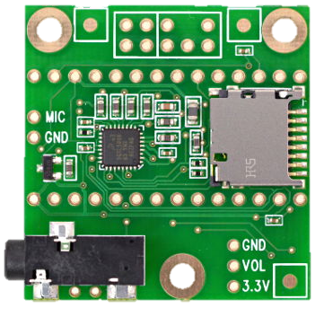

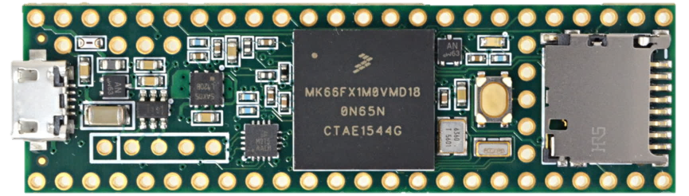
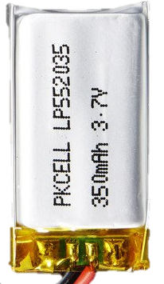
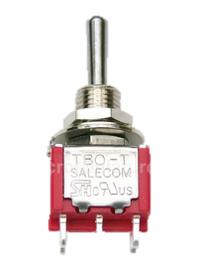
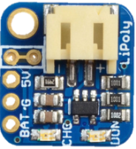
Microphone (Adafruit)
Microphone (Adafruit)
Line-In
Left/Right
3.3V
3.3V
Teensy 3.6
Microcontroller
Headphone
Jack
Battery
(Adafruit)
Teensy
Audio Board
V_{batt}
V_{usb}
Power
Switch
LiPoly Charger (Adafruit)

Slide 2
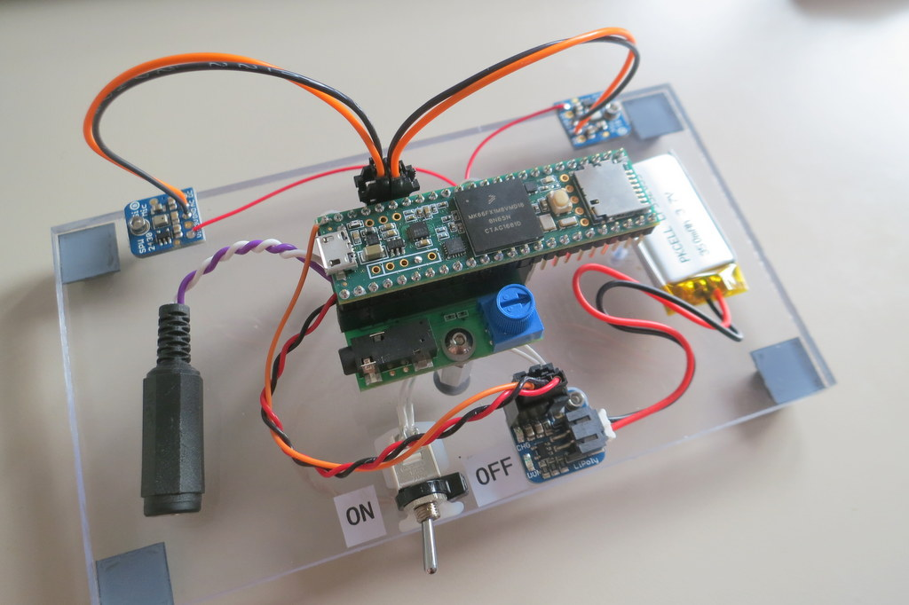
Mic
Mic
Battery
Teensy 3.6
Audio Board
Charger

Slide 3
Teensy Hearing Aid
Plexi-Board Prototype

